Slide 1

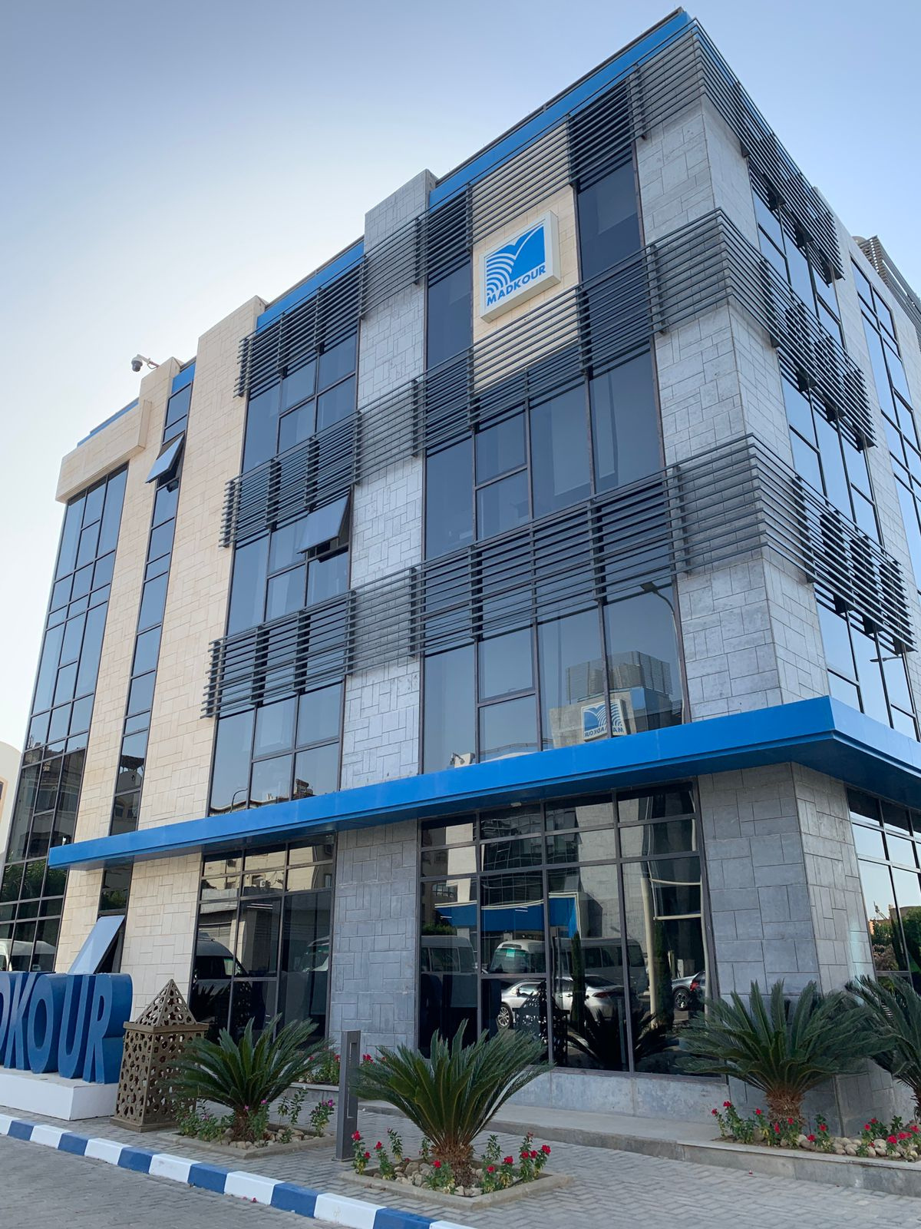



Software Intern
Application Team , IT Department
Special Thanks to:
Eng.Mahmoud Fathy
Presented by:
Mohamed Emad

Slide 2



Table of content:
01
Soft Skills
Orientation week
02
Technical Skills
Form week 02 to week 06
03
Program Outcomes

Slide 3






01
Soft Skills
First week Orientation
Day 01
Day 02
Day 03
Day 04
Oriantation Day
Excel Day
Personal Day
Presentation Day
How to deal with excel sheets
How to deal with some functions in excel
How do we know our strengths and weakness
How to present ourselves in the work market
How to present an info
How to make a professional presentation
Know the history of the company
Know the safety procedure in the company

Slide 4

First week
Day 01
Day 02
Day 03
Day 04
Oriantation Day
Excel Day
Personal Day
Presentation Day
How to deal with excel sheets
How to deal with some functions in excel
How do we know our strengths and weakness
How to present ourselves in the work market
How to present an info
How to make a professional presentation
Know the history of the company
Know the safety procedure in the company

Slide 5

02
Technical Skills
From week 2 to week 6

Slide 6


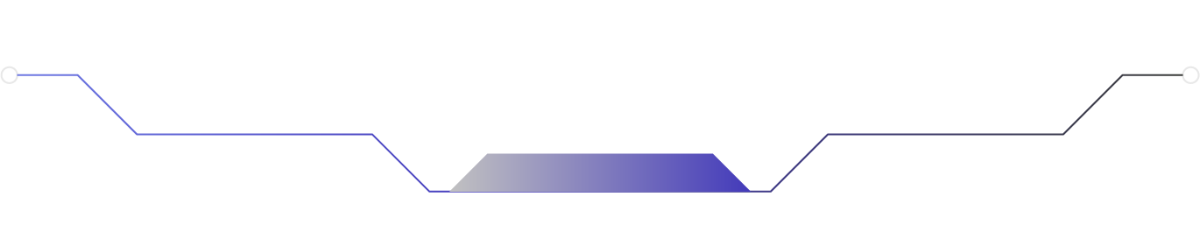
Week 02 & Week 03:
Learn about PHP & its syntax:
What is PHP (now & then)?
Learn about PHP framework (Laravel):
Why we choose Laravel?
Revise the syntax of HTML , CSS & JS
How to get information about PHP and Laravel
Learn about the syntax of PHP
Learn the principles of OOP
Learn how to setup a Laravel environment
The learning outcomes from week 02 & 03

Slide 7
Week 04:
Completed a couple of simple tasks to use the knowledge that had gained:
Add , delete &edit data
Upload picture
Use mySQL on phpMyAdmin to work on database-related tasks
How to deal with bugs in a code
Improve problem-solving
Learn how to think effectively
Learn how to deal with file upload
Learn how to deal with ajax requests
The learning outcomes from week 04

Slide 8
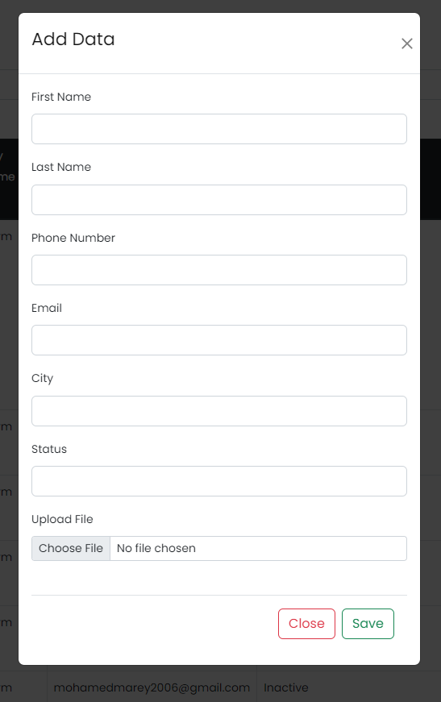
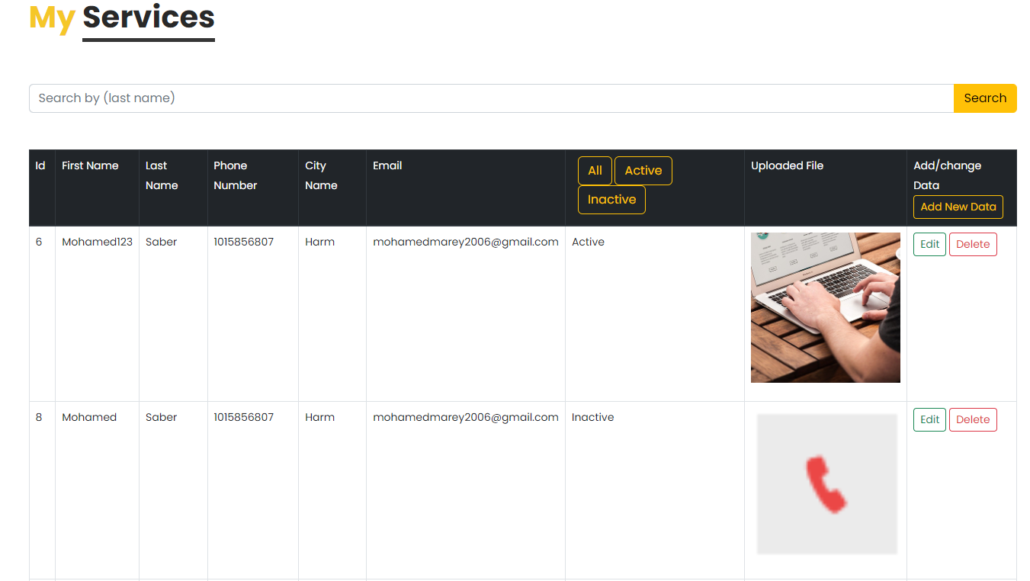
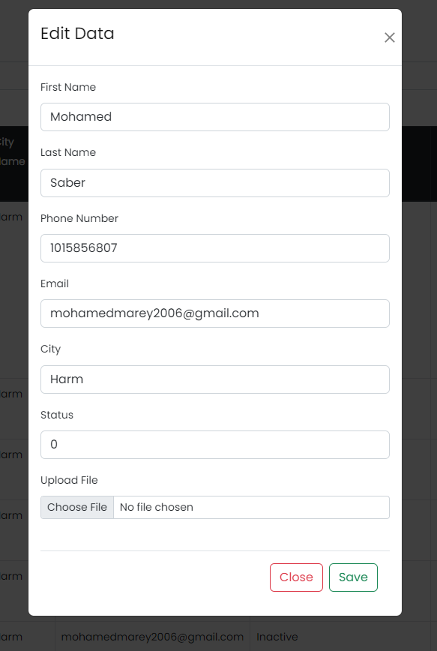
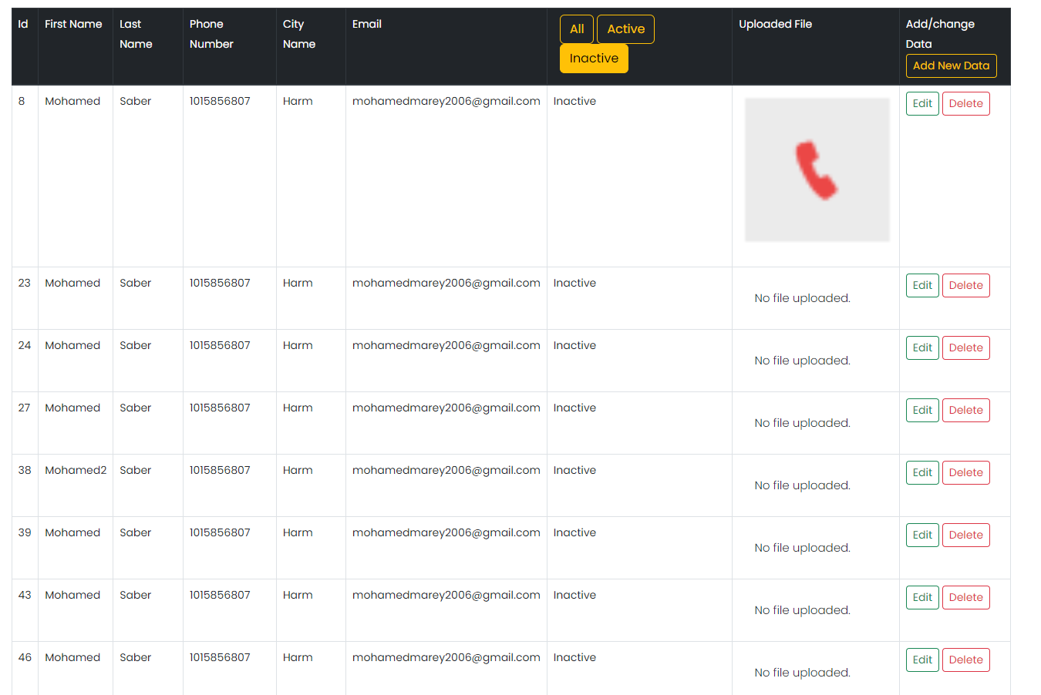
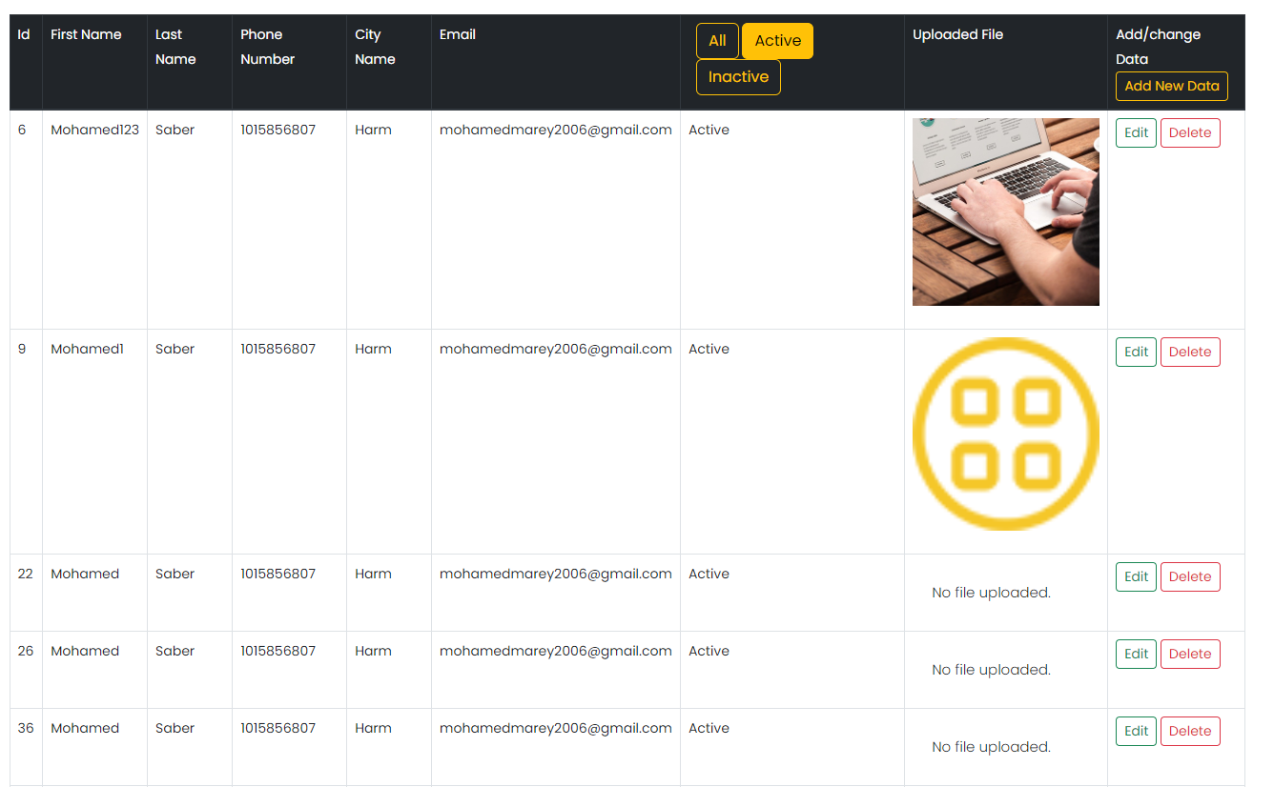
Week 04:

Slide 9
Week 05 & Week 06:
Start to implement a new project (Storehouse):
Have a login page & requests to a specific item in the store
Learn about relationships in (Laravel):
To highlight each database tables relations with each other
Learn about session in (Laravel):
To specify each page to a specific user
How to deal with bootstrap to make a prettier design
How to make a one-to-many relation in database tables
How to handle several pages access
The learning outcomes from week 05 & 06

Slide 10
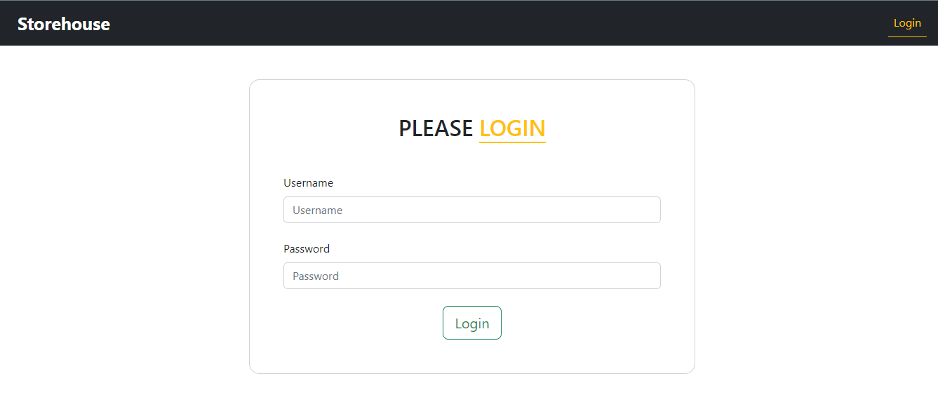
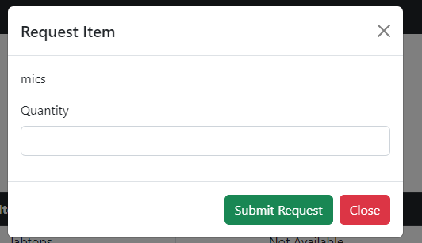
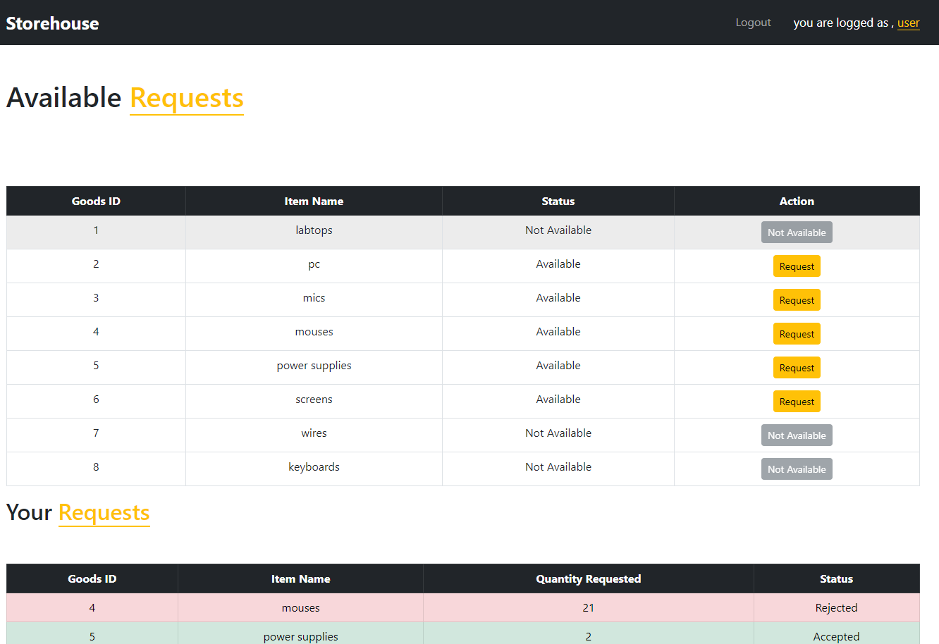
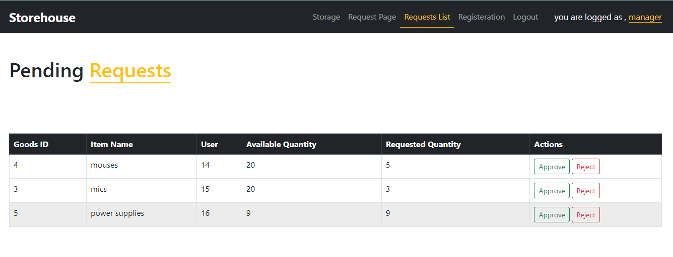
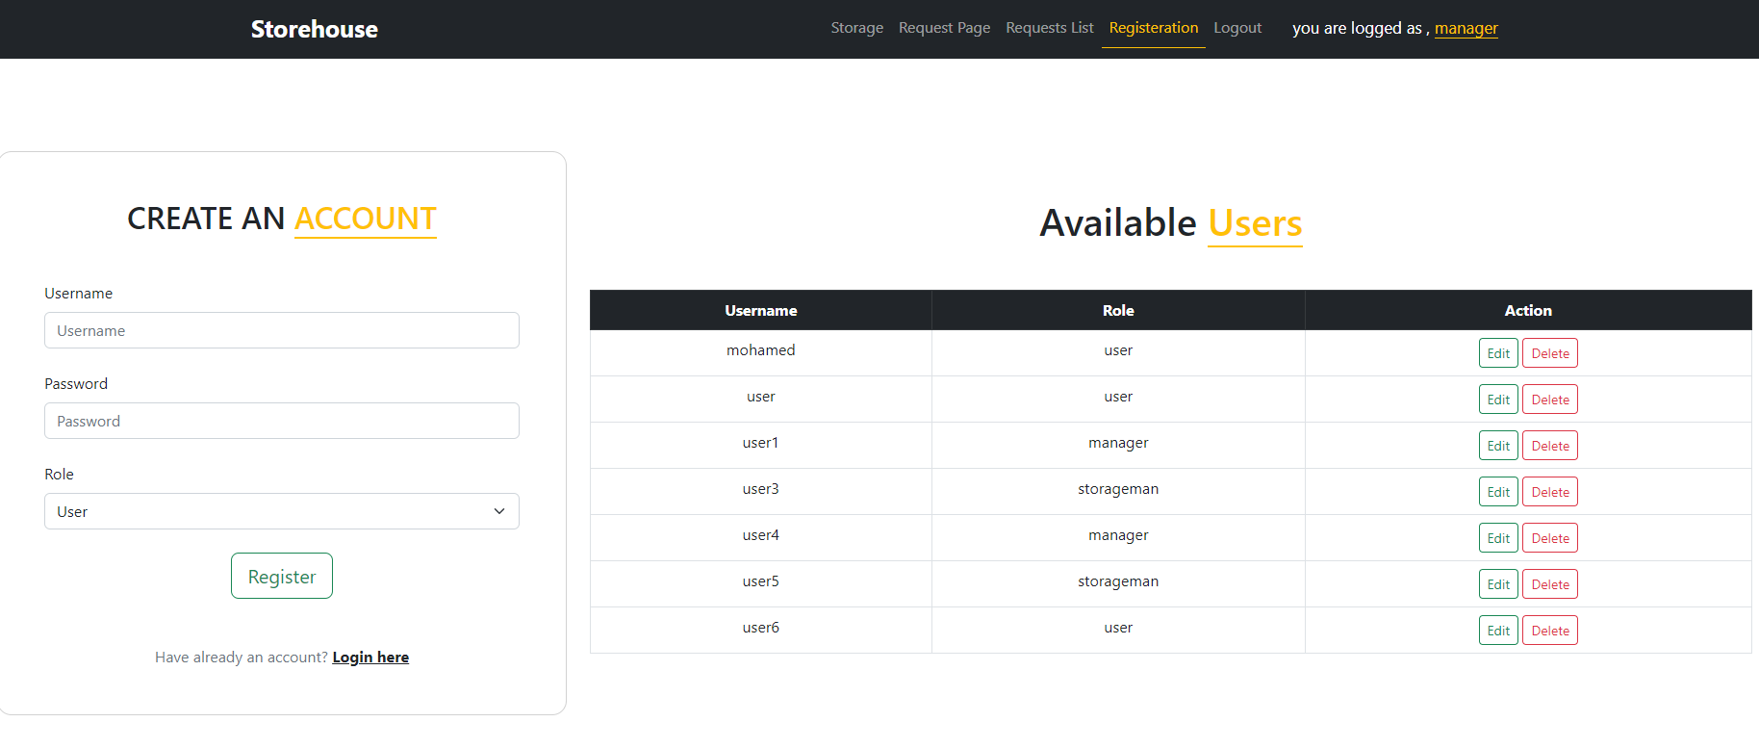
Week 05 & Week 06:

Slide 11
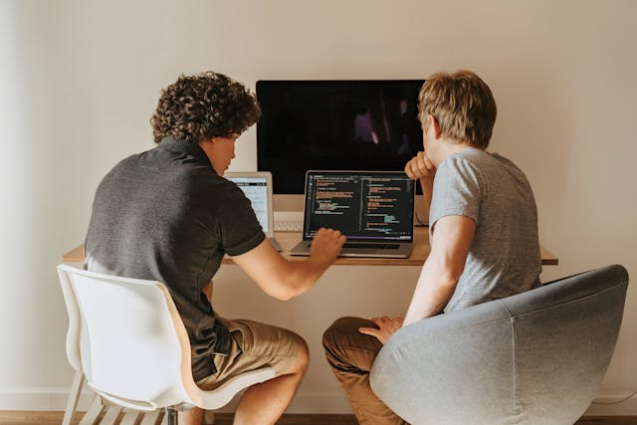
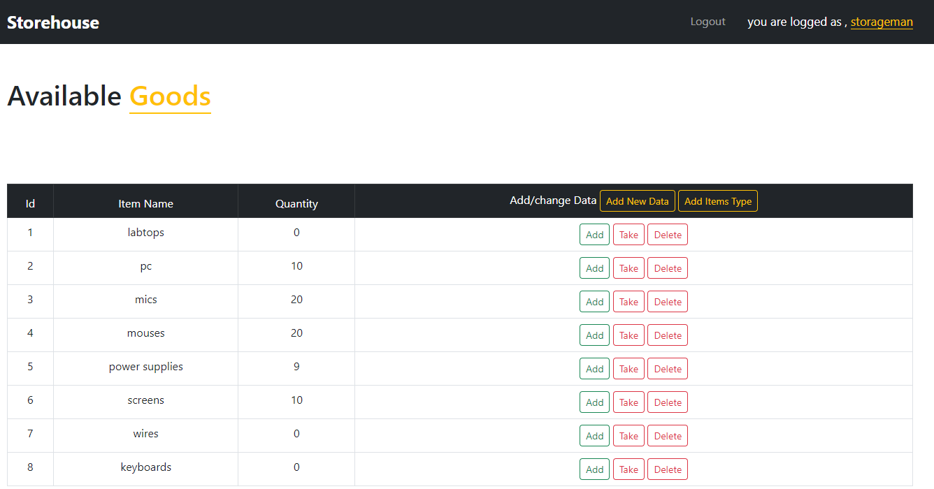
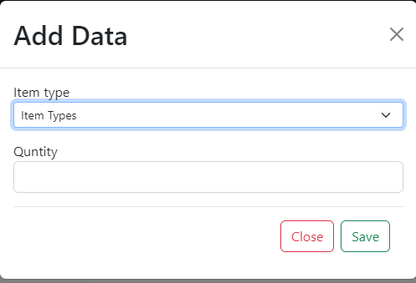
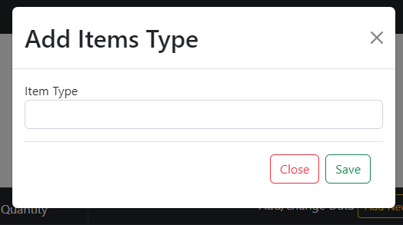
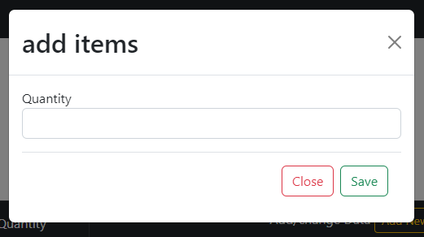
Week 05 & Week 06:

Slide 12
03
Program Outcomes
Program outcomes

Slide 13

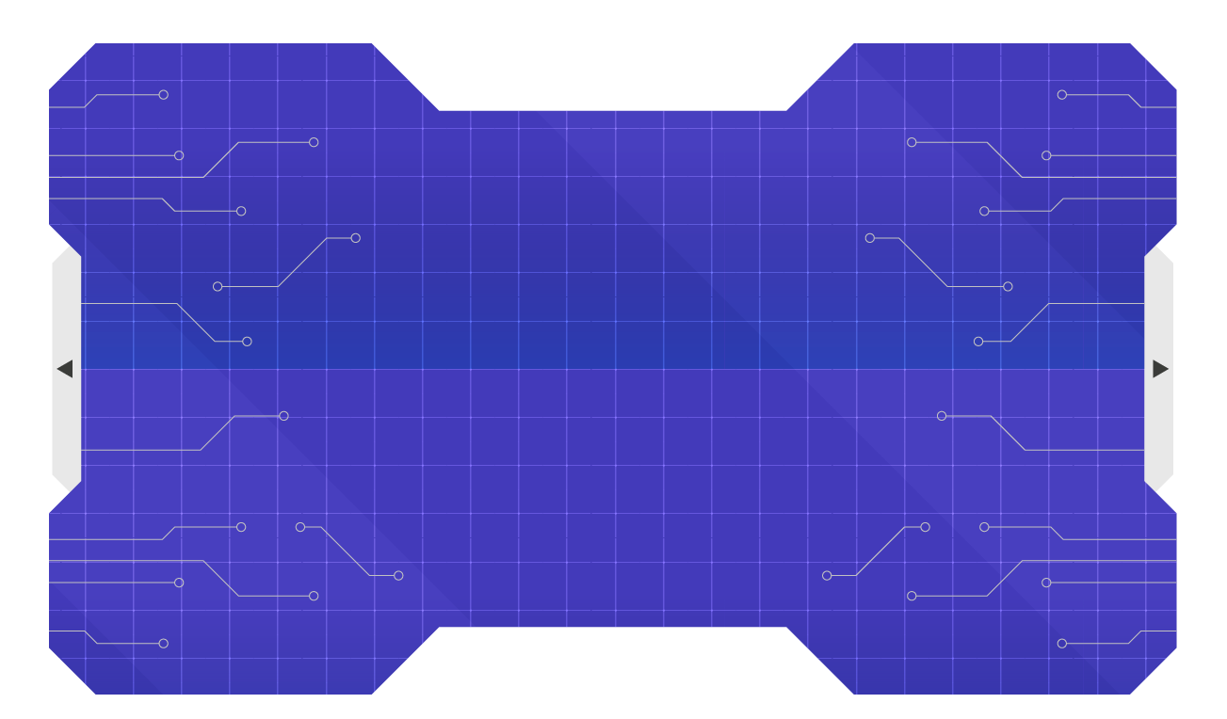
Program Outcomes:
01
Networking with industry professionals
02
Problem solving
03
Team collaboration
Exposure to different technologies & tools
04
Program outcomes
05
Search base learning
Work in a real project
06
07
implementing base learning
Critical thinking
08

Slide 14

Thanks for listening
Special Thanks to:
Madkour Academy

